Slide 1
ICAT-EGVE 2023 Slide Template
John Dingliana and Michael Manzke
School of Computer Science and Statistics, Trinity College Dublin

Slide 2
Overview
ICAT-EGVE is the joint International Conference on Artificial Reality and Telexistence (ICAT) & Eurographics Symposium on Virtual Environments (EGVE). Together, these are two of the oldest international conferences in the world on Artificial Reality and Virtual Environments.
  The conference, which will be held wholly in-person this year, features a technical program of papers, keynote talks, posters and demos on topics including but not limited to Virtual Environments, Telexistence, the Metaverse and Virtual Social Interactions in VR/AR/MR/XR.
  Please see the following link for information on previous iterations of this conference: https://icat.vrsj.org/

Slide 3

Venue
The conference will be held at Trinity College Dublin, a 430-year-old college steeped in history and tradition but, at the same time, immersed in a culture of technological innovation.

Slide 4
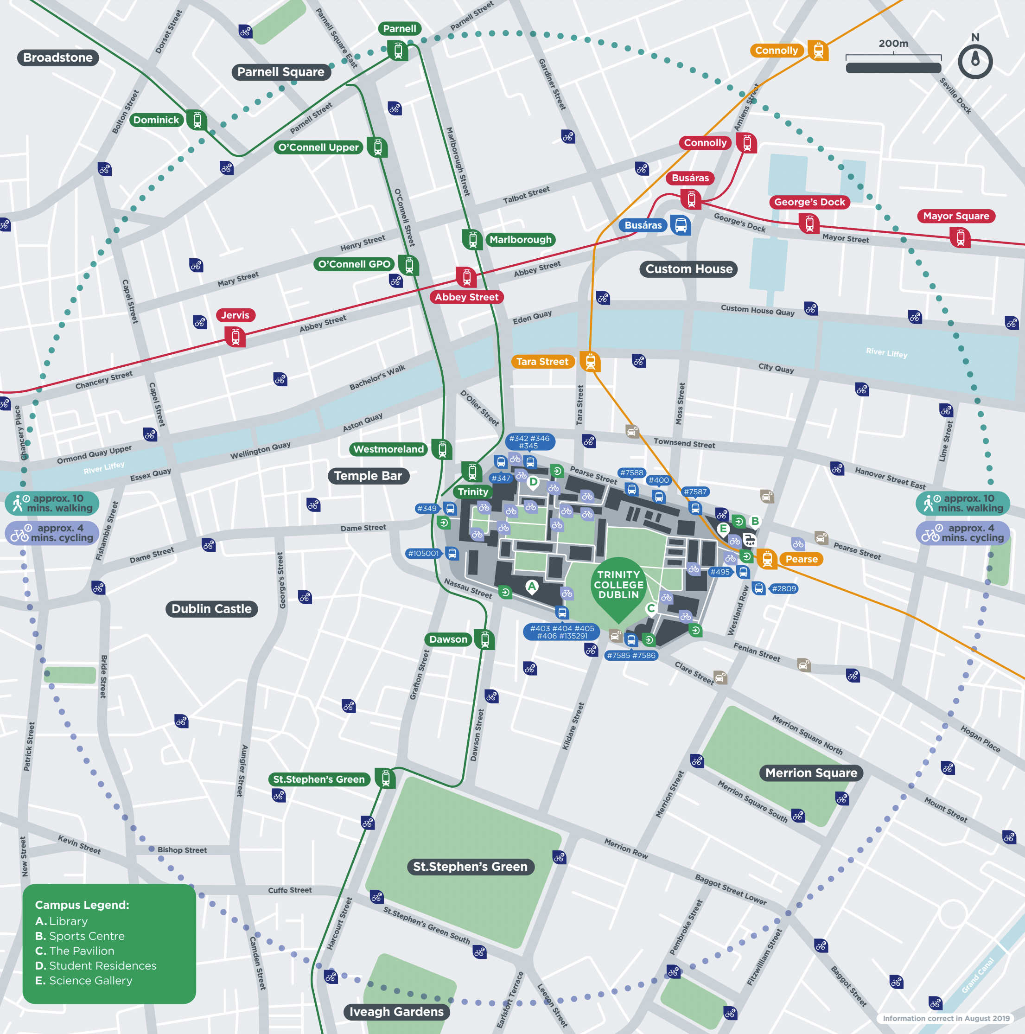
Getting There
Dublin is directly accessible from many international hubs
TCD lies 10 km from Airport, in the centre of the city, easily reached via public transport bus, airport coach, taxi or car
    Taxi / 20-30 minutes / €20-€40
    Dublin Express / 15-30 minutes / €8
    Aircoach / 30-40 minutes / €7
    Dublin Bus / 30-50 minutes / €1 - €3

